Slide 1

WIPRO NGA Program – Datacenter Batch
Capstone Project Presentation – 06 April 2024
Project Title - Task 1
Presented by - Avdhut Sanjay Bhaldand
www.rpsconsulting.in

Slide 2
Objective :
Create a domain controller using domain name as <yourname>.training and create a shared NFS folder (c:\sharables) on domain controller machine with read-only permissions and access this folder on the member machine.
www.rpsconsulting.in

Slide 3
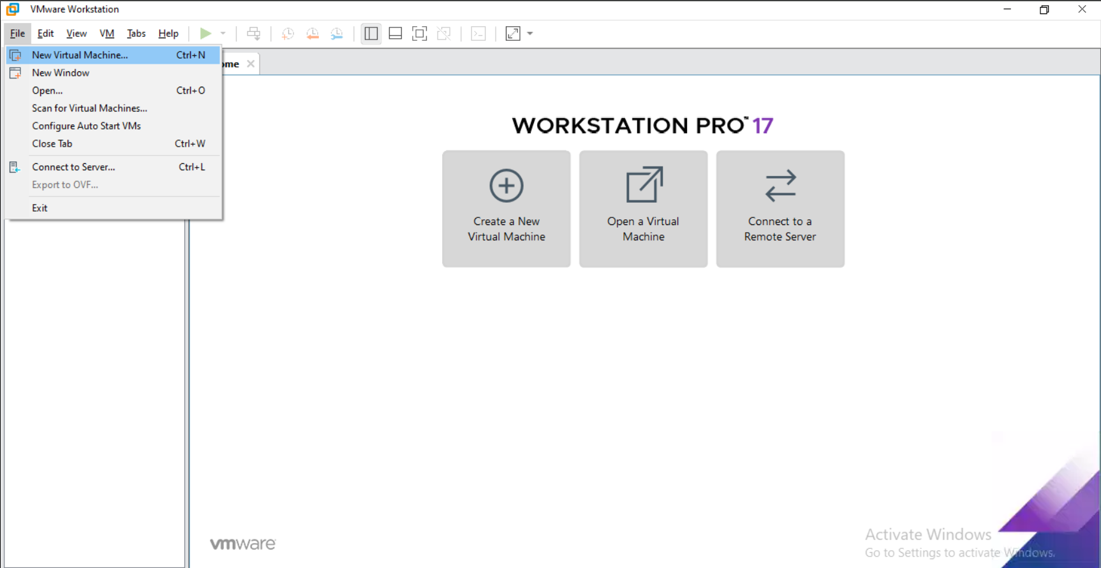
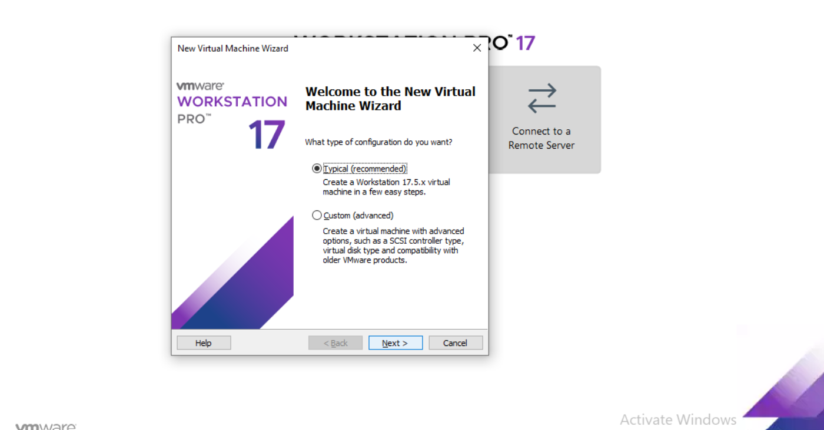

Create a windows server 2016 as domain controller
Select New Virtual Machine-
Select Typical-
2024 - RPS Consulting all rights reserved

Slide 4
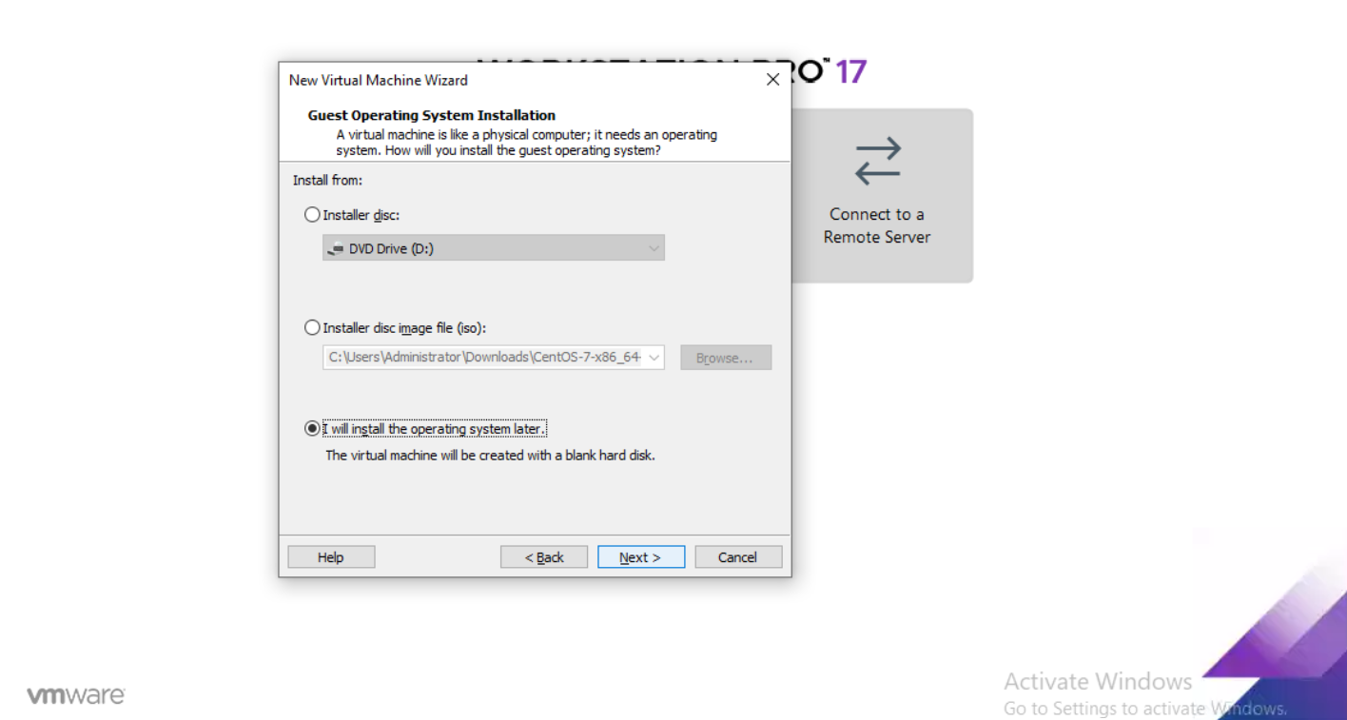
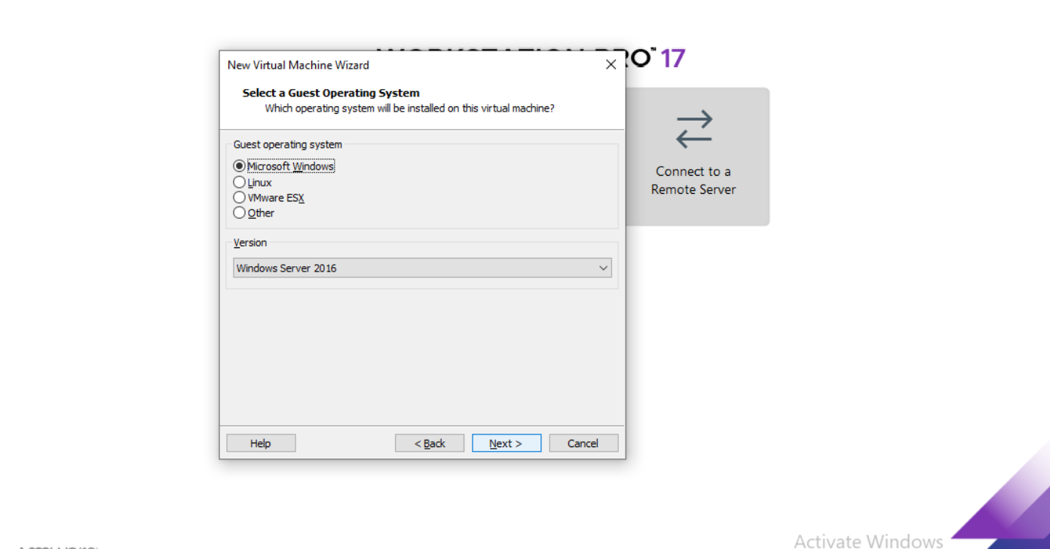
Select I will install later-
Select the Windows Server Version-
2024 - RPS Consulting all rights reserved

Slide 5
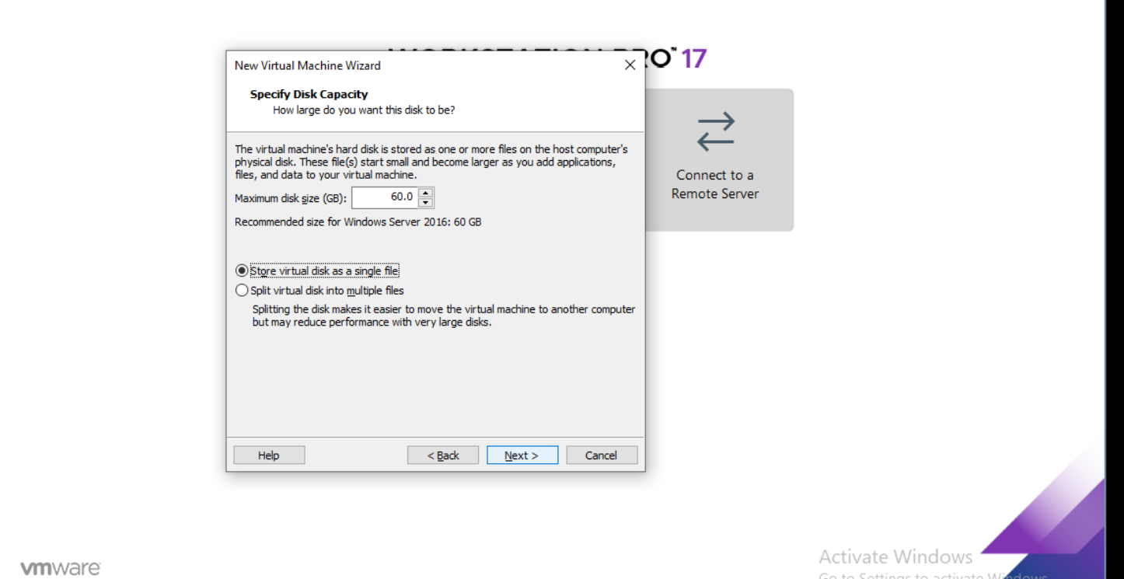
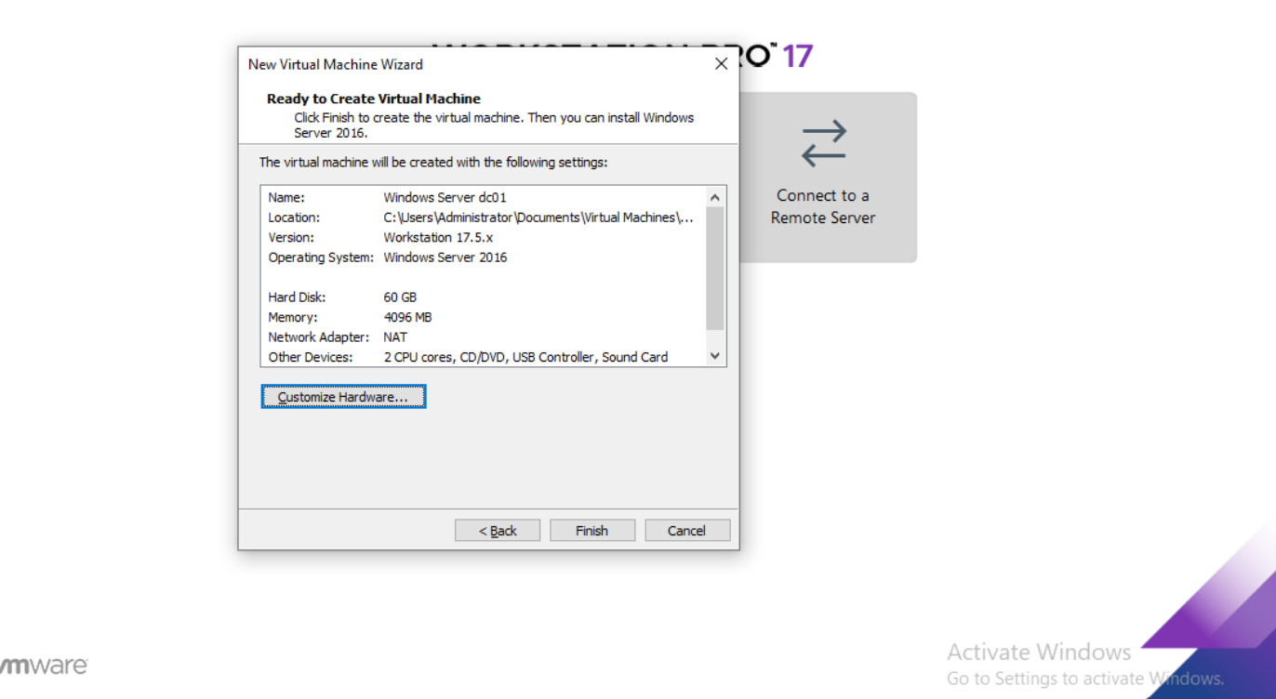
Specify the disk capacity-
Select Customize Hardware-
2024 - RPS Consulting all rights reserved

Slide 6
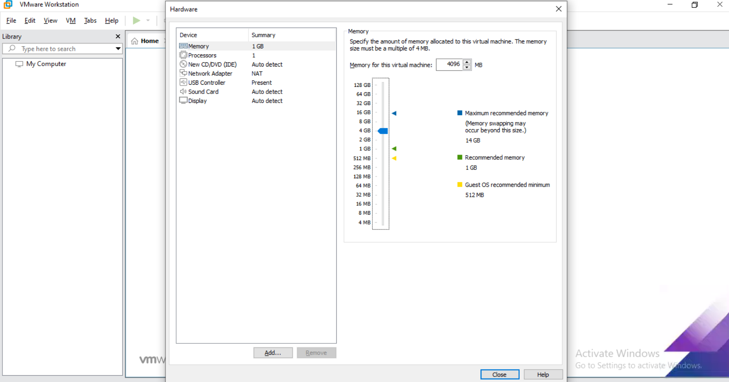
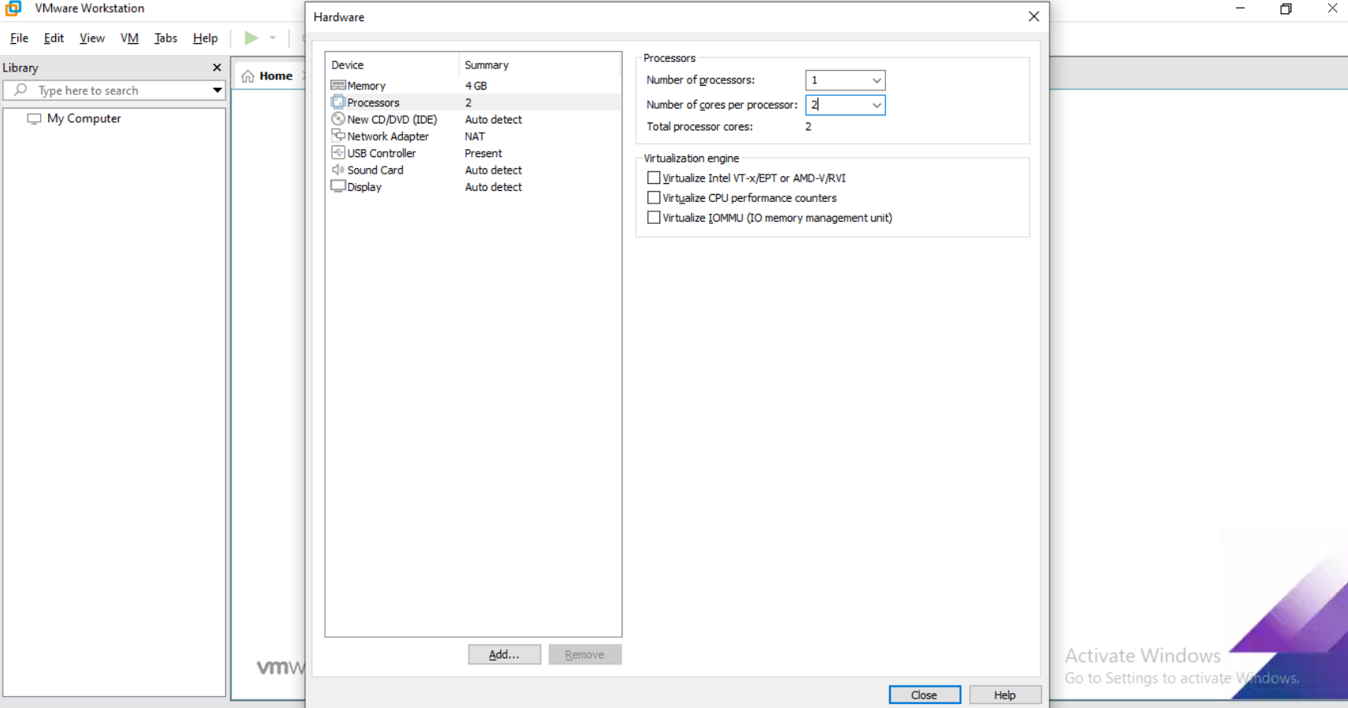
Select memory size-
Select number of processors -
2024 - RPS Consulting all rights reserved

Slide 7
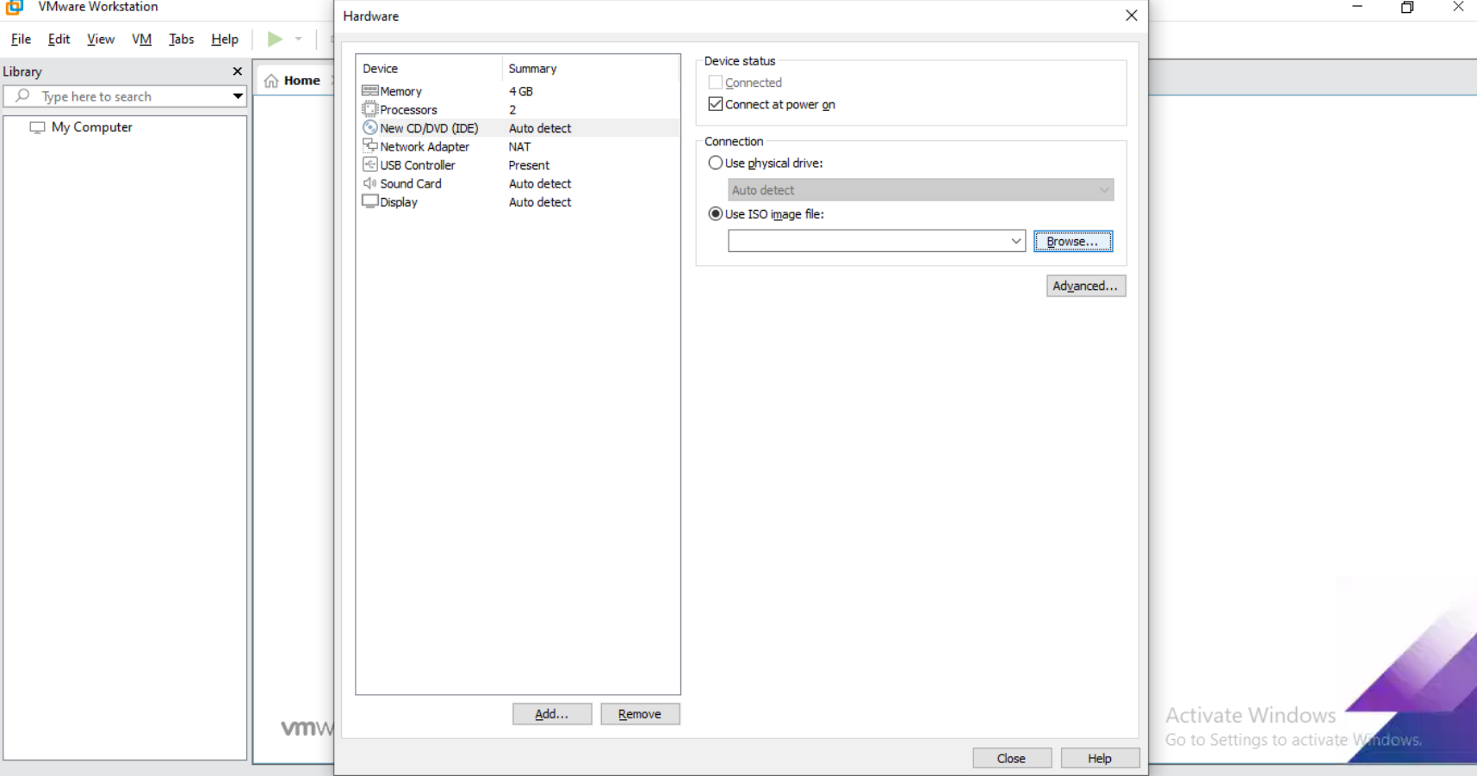
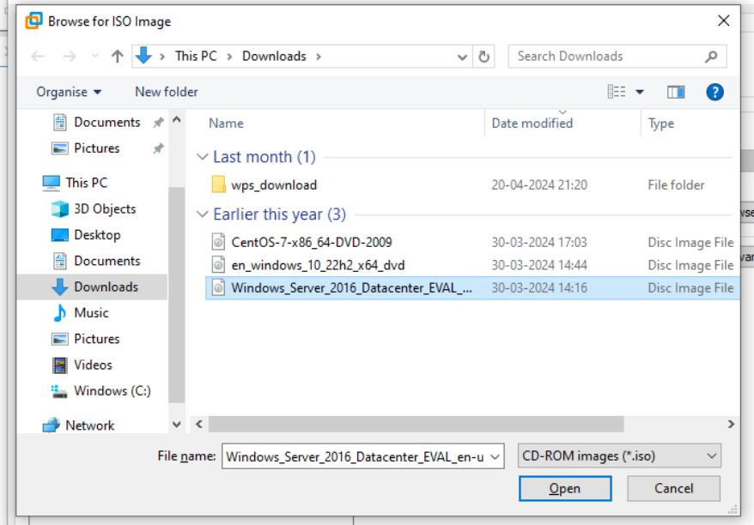
Select Use ISO image file option-
Browse and select the Server ISO image file-
2024 - RPS Consulting all rights reserved

Slide 8
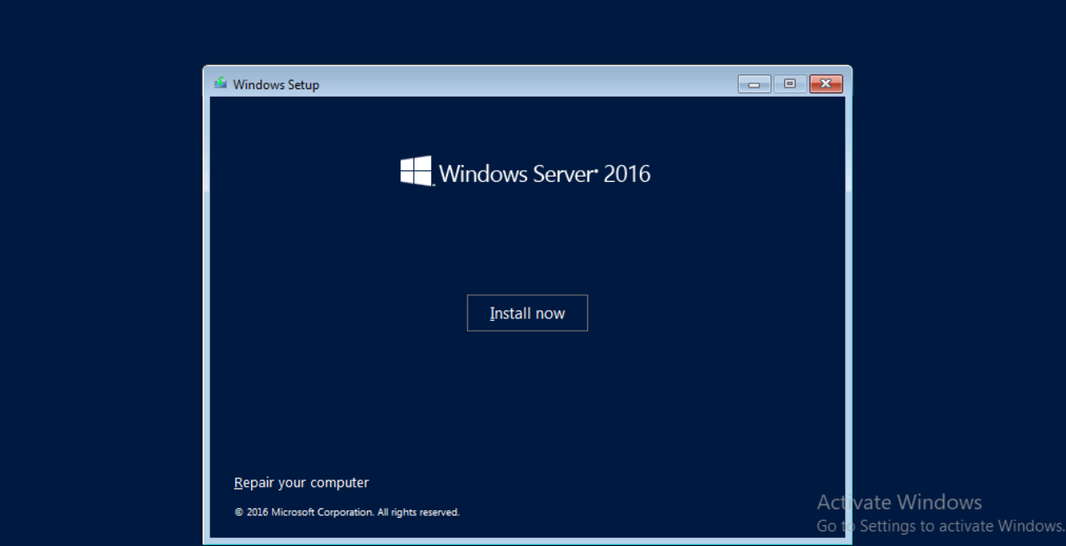
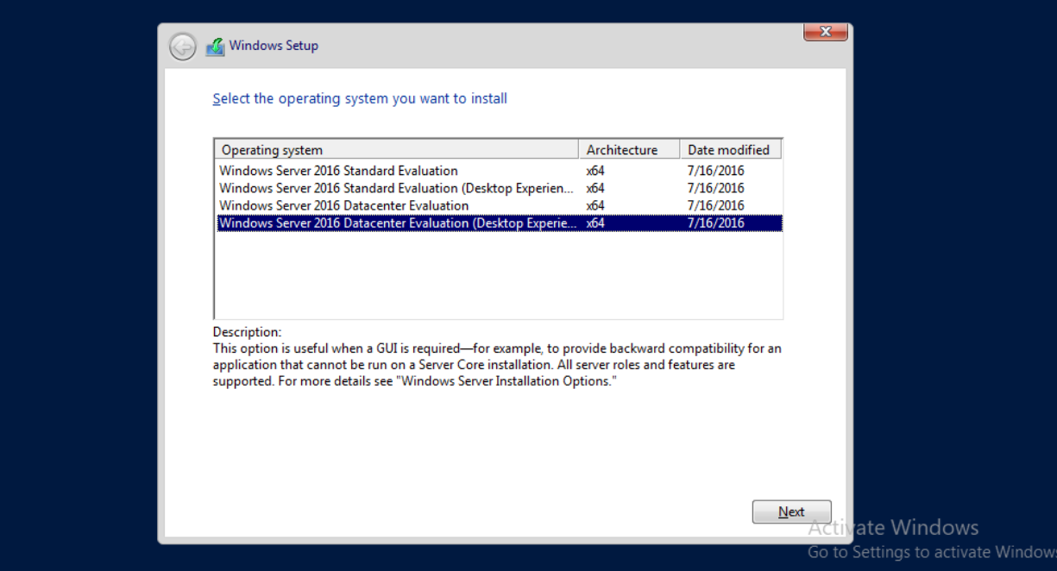
Click on Install Now-
Select the Windows Server 2016 Datacenter
Evaluation(Desktop Experience) for GUI -
2024 - RPS Consulting all rights reserved

Slide 9
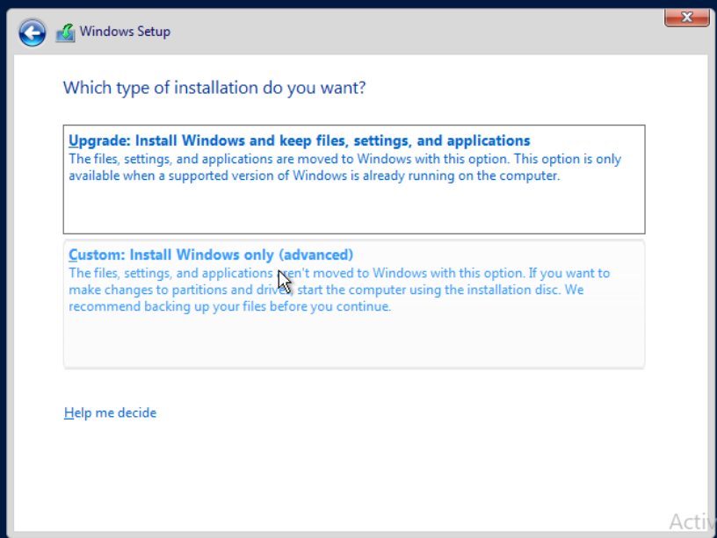
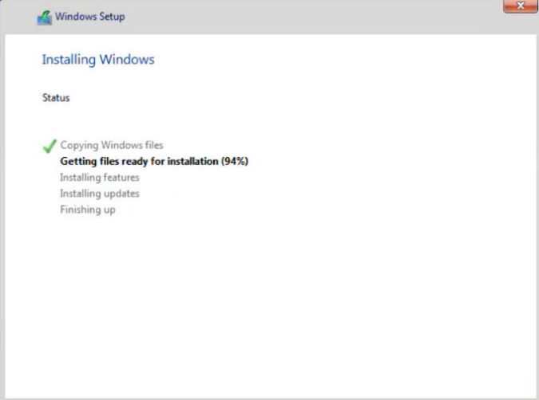
Select Custom -
Installation started-
2024 - RPS Consulting all rights reserved

Slide 10
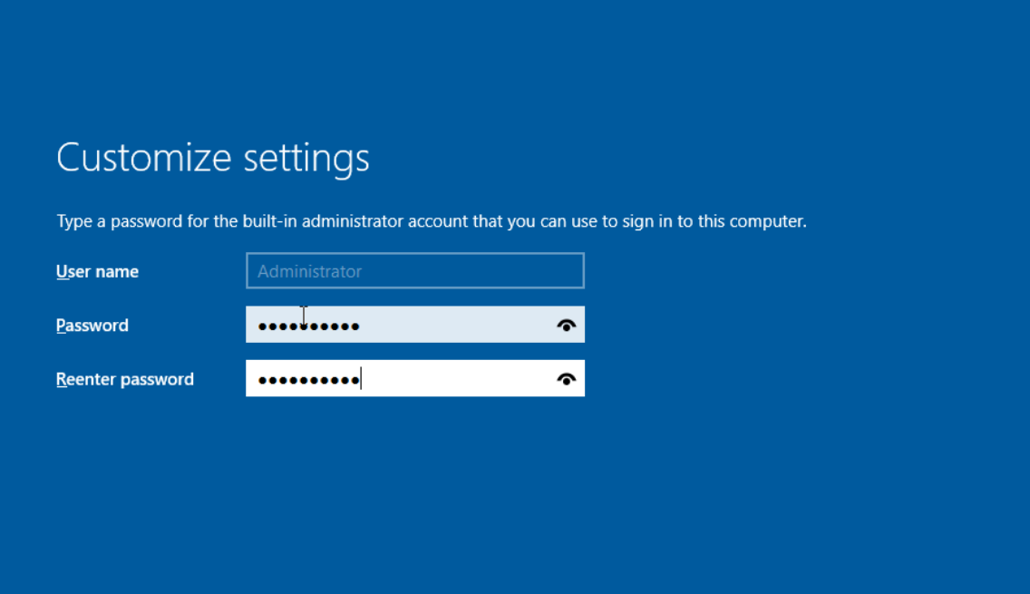
Enter the password provided for administrator -
2024 - RPS Consulting all rights reserved

Slide 11
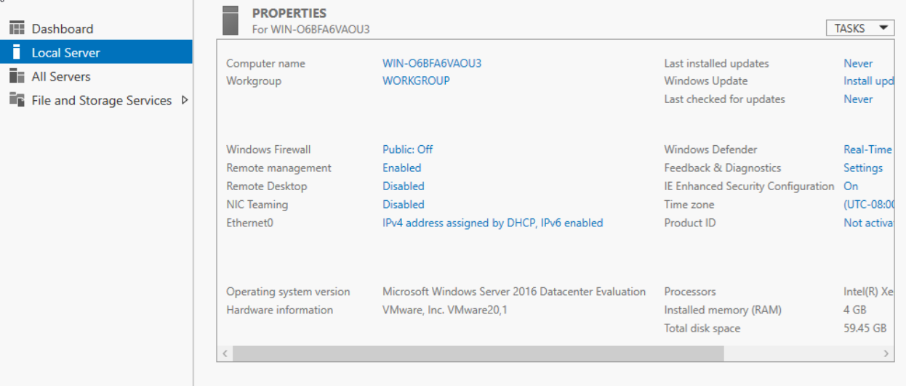
Windows server is ready for post-installation configuration-
Firewall - off
Time Zone - Asia/Kolkata
Ethernet0 - Specify the IP Address and DNS loopback address
2024 - RPS Consulting all rights reserved

Slide 12
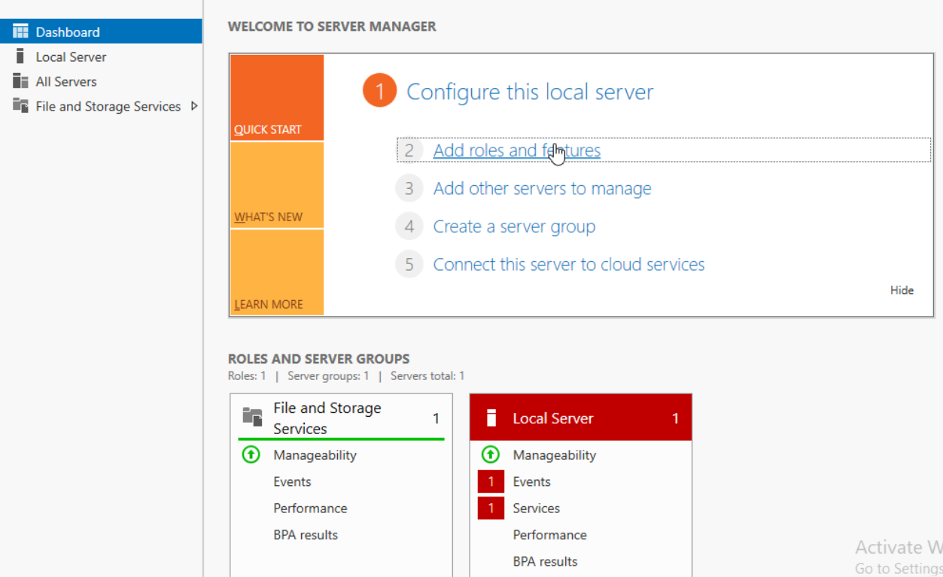
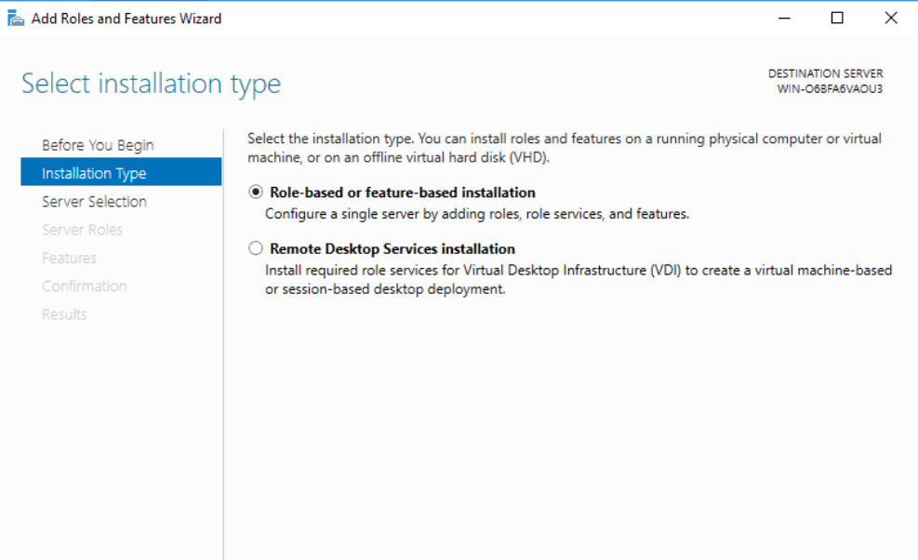
Click on Add roles and features to add ADDS roles -
Select Role-based installation-
2024 - RPS Consulting all rights reserved

Slide 13
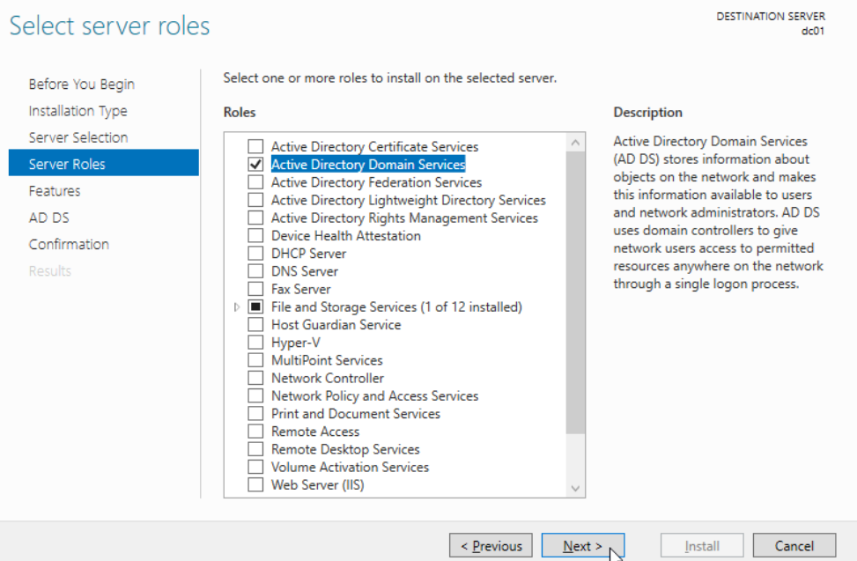
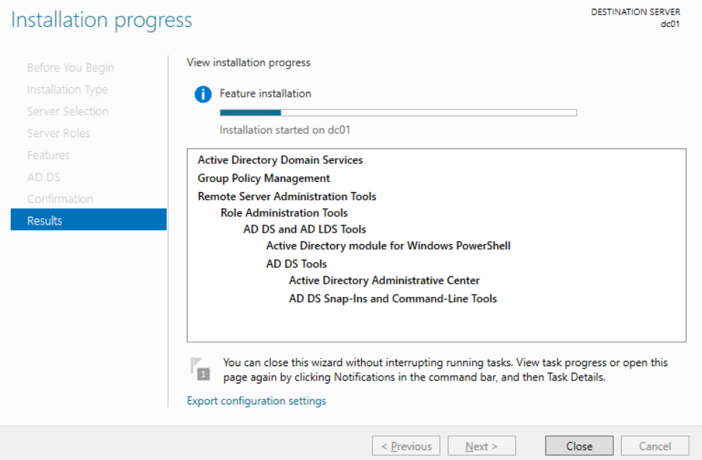
Select the ADDS role and add features -
2024 - RPS Consulting all rights reserved

Slide 14
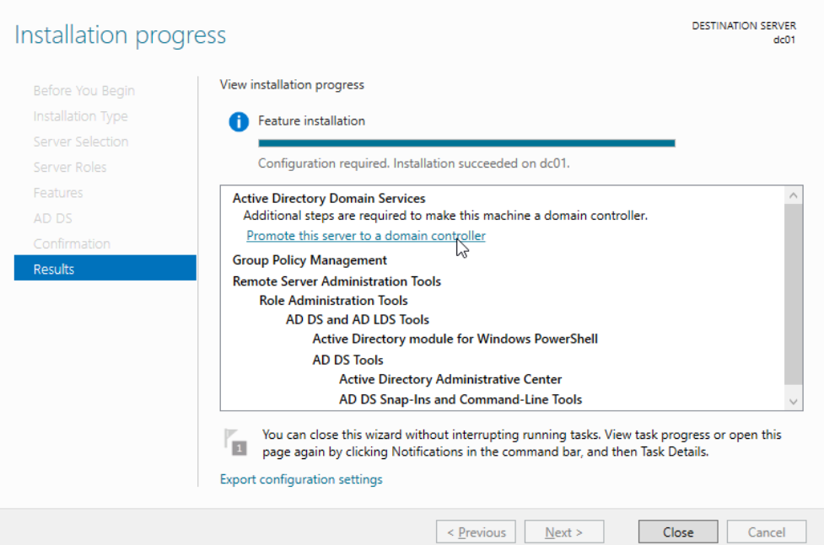
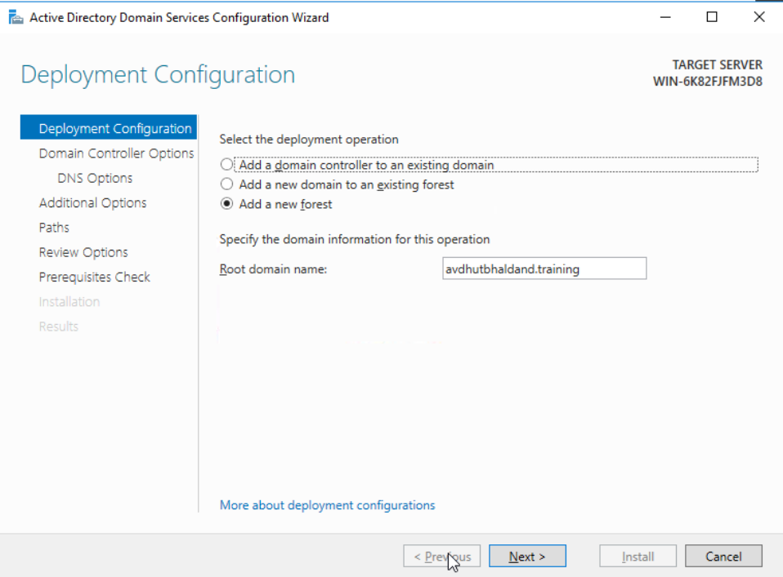
Click on the Blue line to promote server to domain controller-
Click on Add a forest and specify domain name
2024 - RPS Consulting all rights reserved

Slide 15
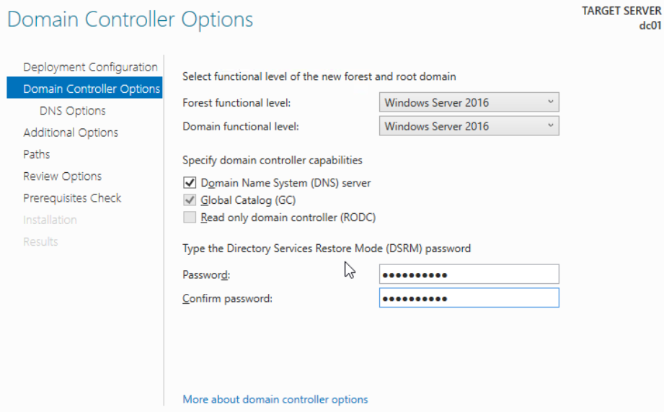
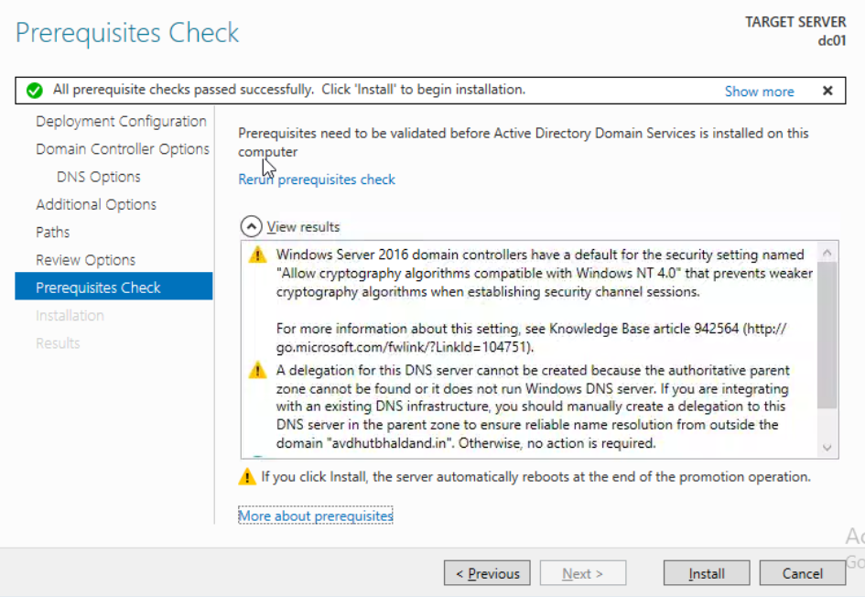
Give the Password for domain and Click on Install -
2024 - RPS Consulting all rights reserved

Slide 16
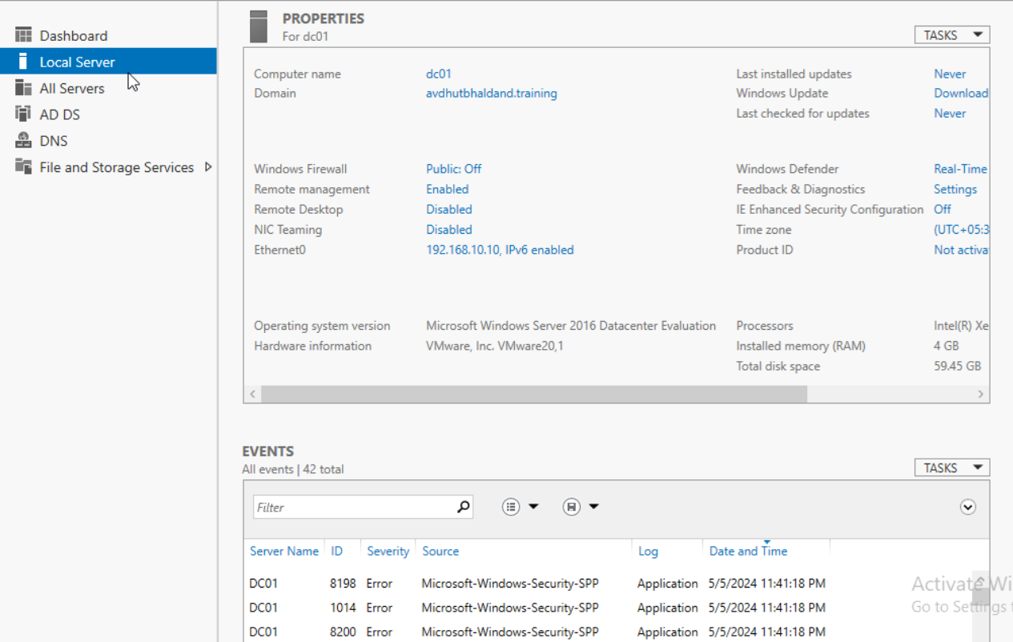
Now the Server is promoted to Domain Controller and the ADDS
roles & featurs are installed-
2024 - RPS Consulting all rights reserved

Slide 17
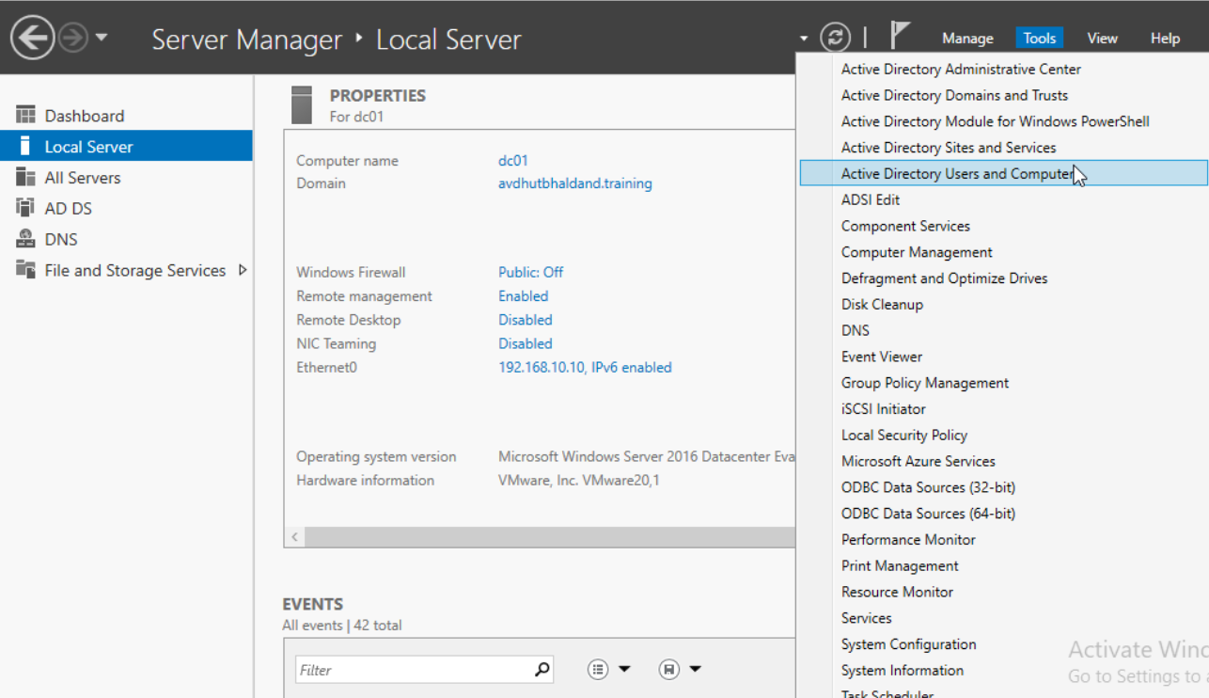
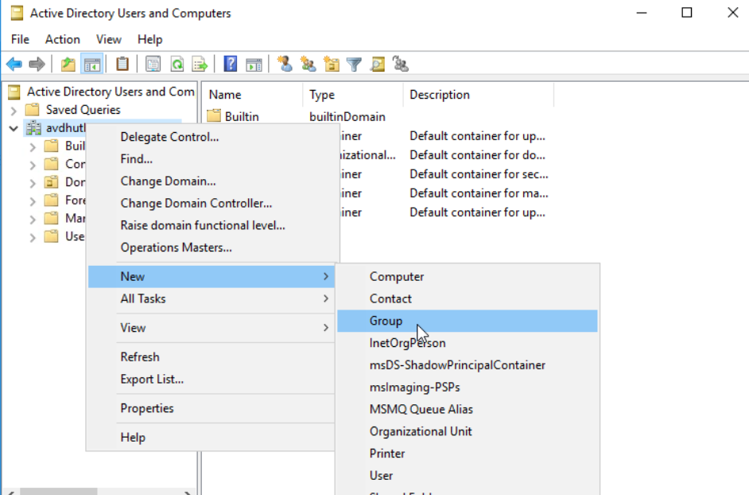
Open Active Directory Users and Computers -
Add Group “dcadmins” in domain-
2024 - RPS Consulting all rights reserved

Slide 18
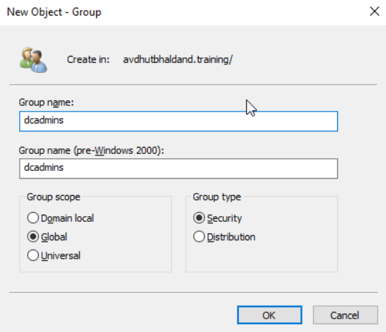
Create a group ‘dcadmins’ in the domain-
2024 - RPS Consulting all rights reserved

Slide 19
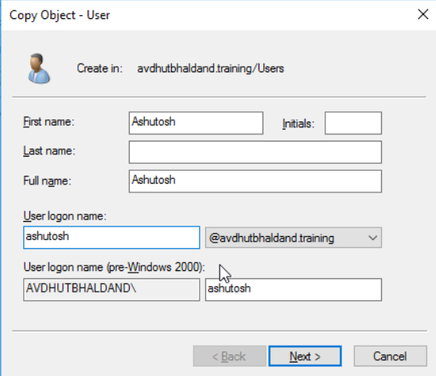
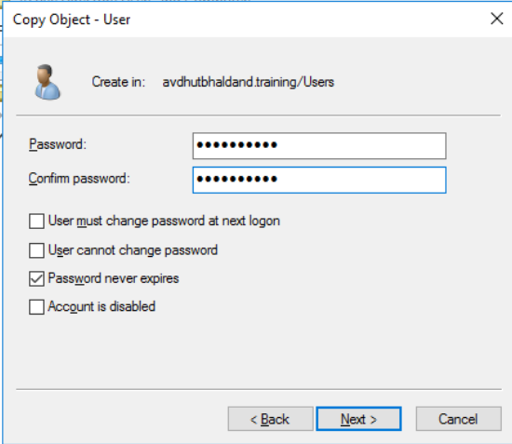
Add 2 users in the dcadmins group-
2024 - RPS Consulting all rights reserved

Slide 20
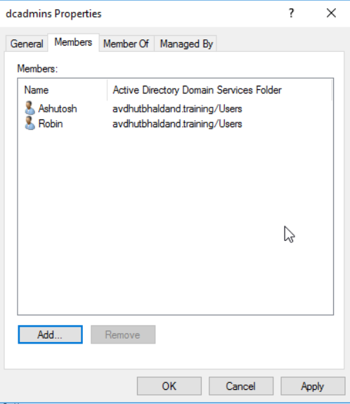
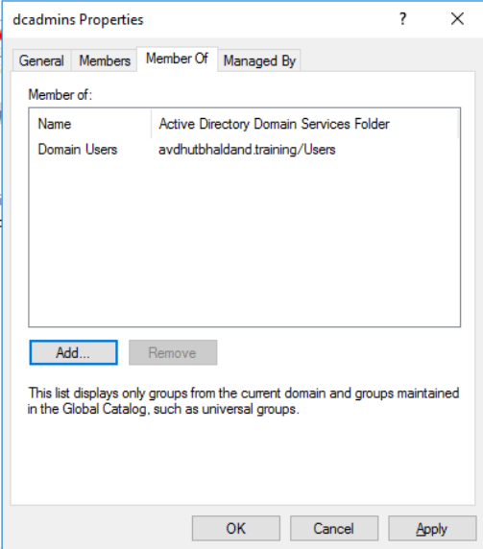
Add the users in the group-
Give the Group Domain Admins priorities-
2024 - RPS Consulting all rights reserved

Slide 21
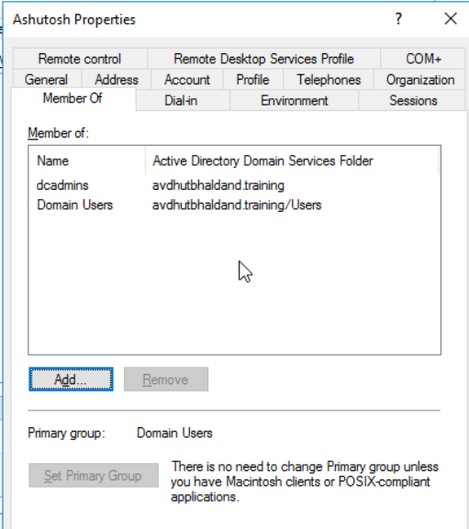
Add the users in the group-
2024 - RPS Consulting all rights reserved

Slide 22
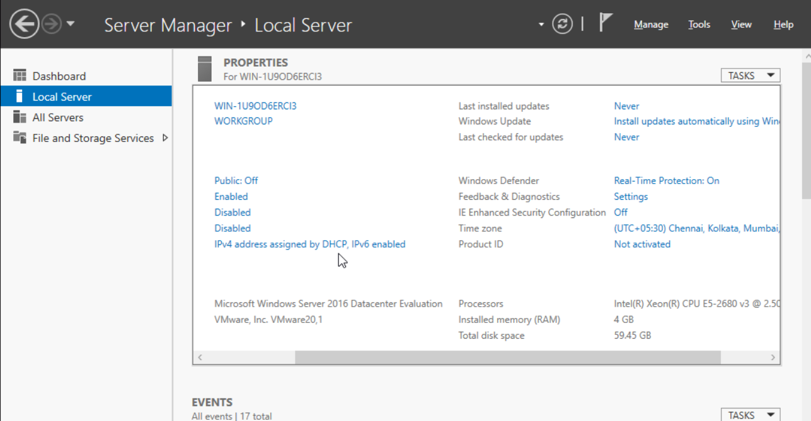
Create another Windows server member machine-
Firewall - off
Time Zone - Asia/Kolkata
Ethernet0 -Specify IP Address & Domain join the member to dc
2024 - RPS Consulting all rights reserved

Slide 23
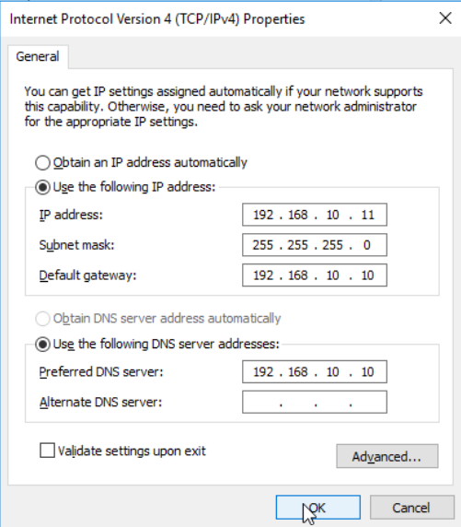
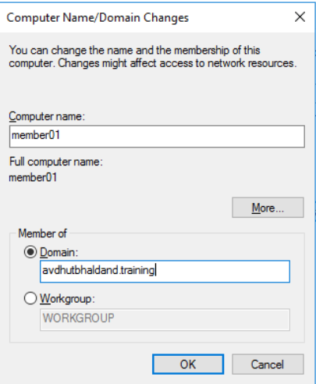
Domain join the member machine -
2024 - RPS Consulting all rights reserved

Slide 24
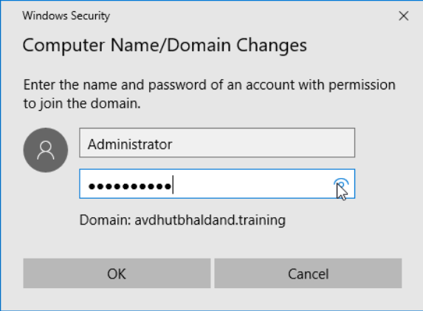
Give domain privileges to member machine_x0002_
2024 - RPS Consulting all rights reserved

Slide 25
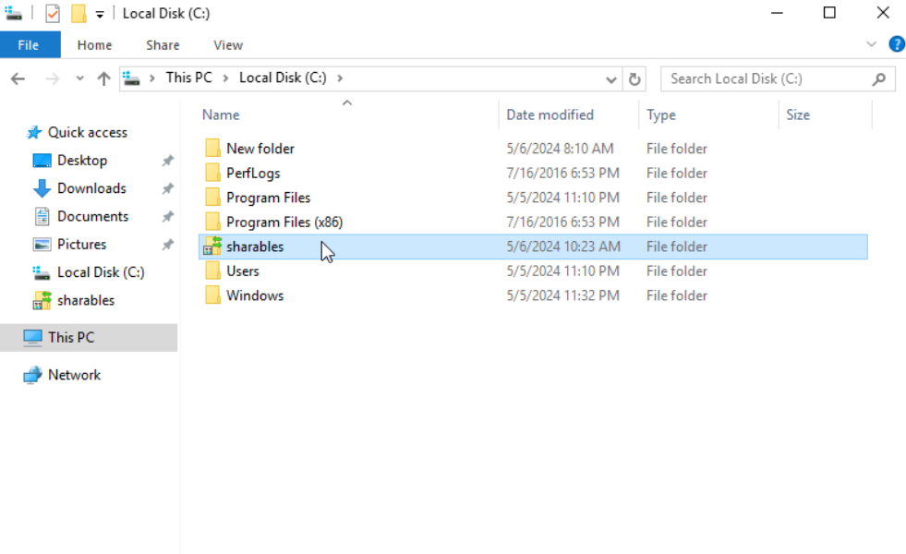
Create a shared NFS folder (c:\sharables) on domain controller-
2024 - RPS Consulting all rights reserved

Slide 26
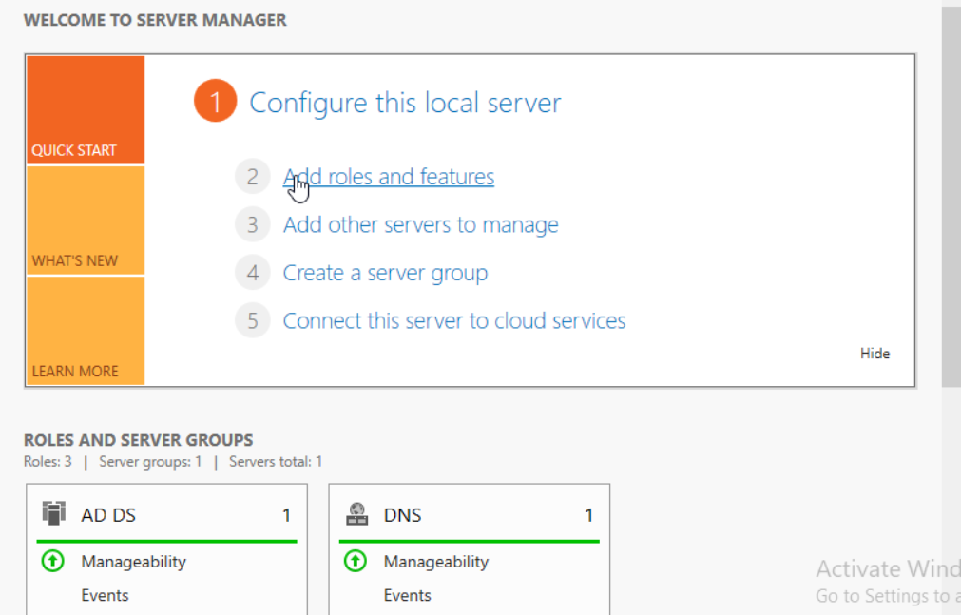
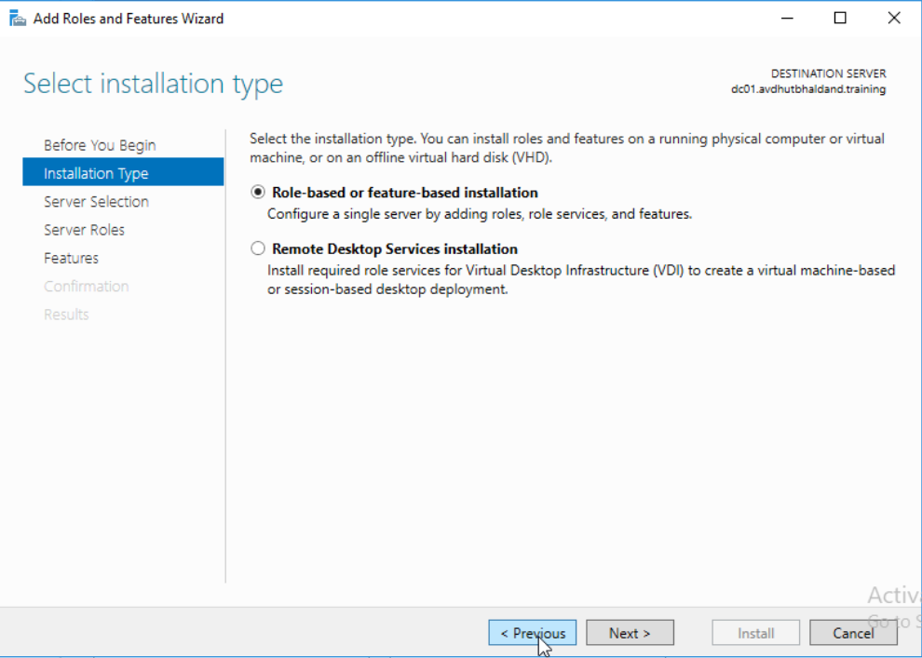
Click Add roles and features on dc machine-
Select Installation type-
2024 - RPS Consulting all rights reserved

Slide 27
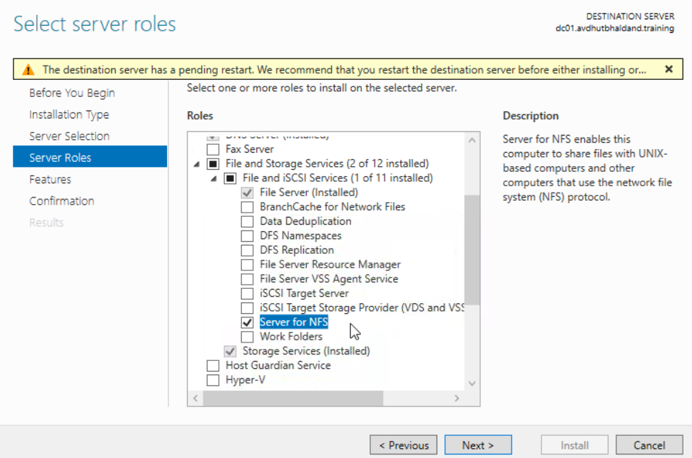
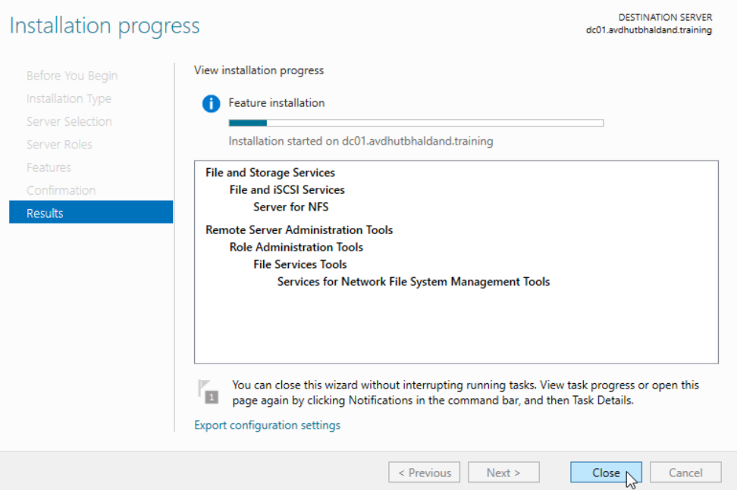
Select Server for NFS and install -
2024 - RPS Consulting all rights reserved

Slide 28
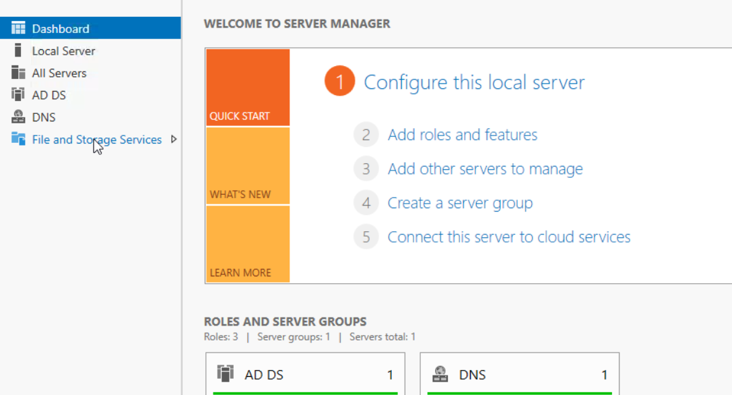
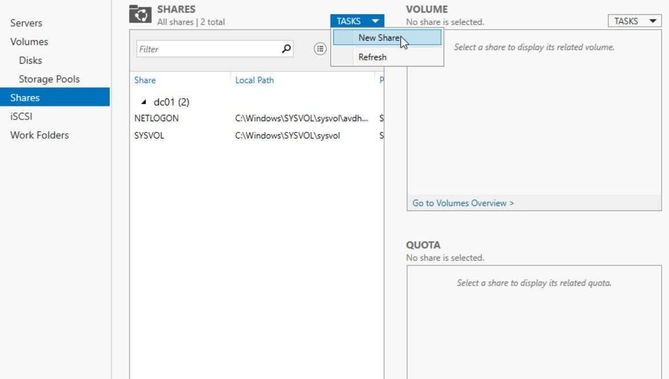
Open File and Storage Services -
Select Shares & in Tasks select new Share-
2024 - RPS Consulting all rights reserved

Slide 29
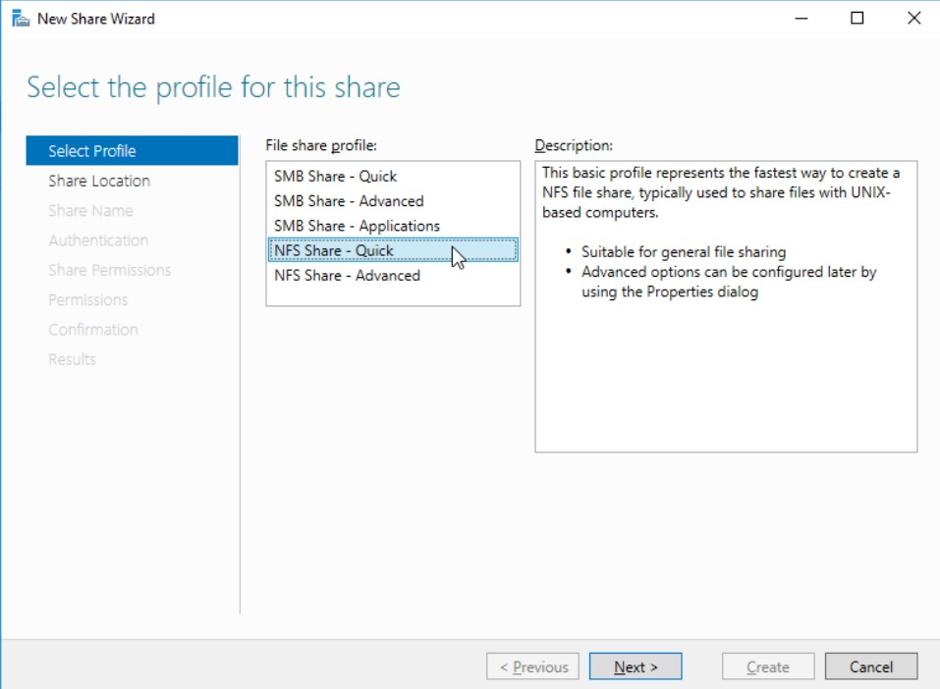
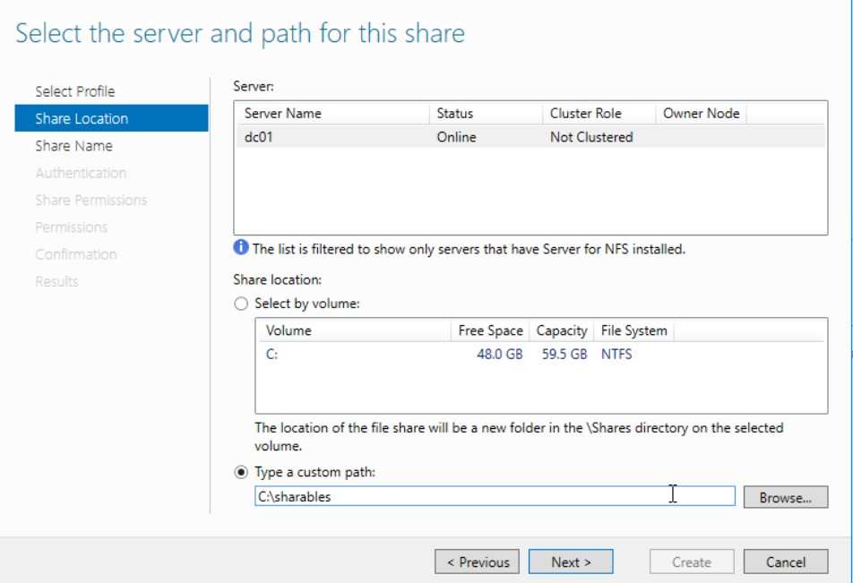
Select NFS Share-Quick -
Select Location of the folder ‘sharables’ -
2024 - RPS Consulting all rights reserved

Slide 30
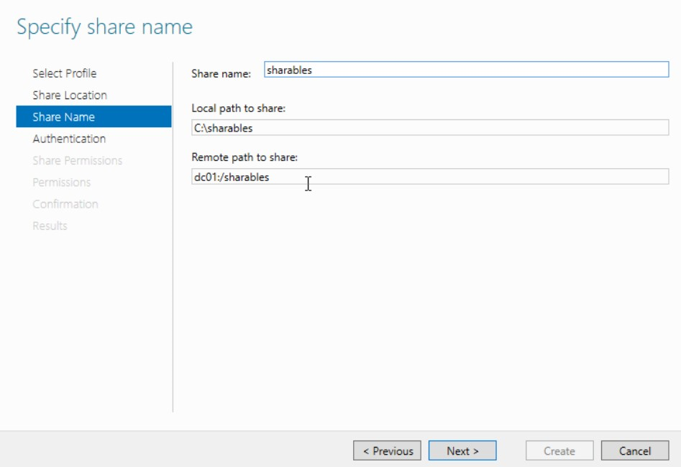
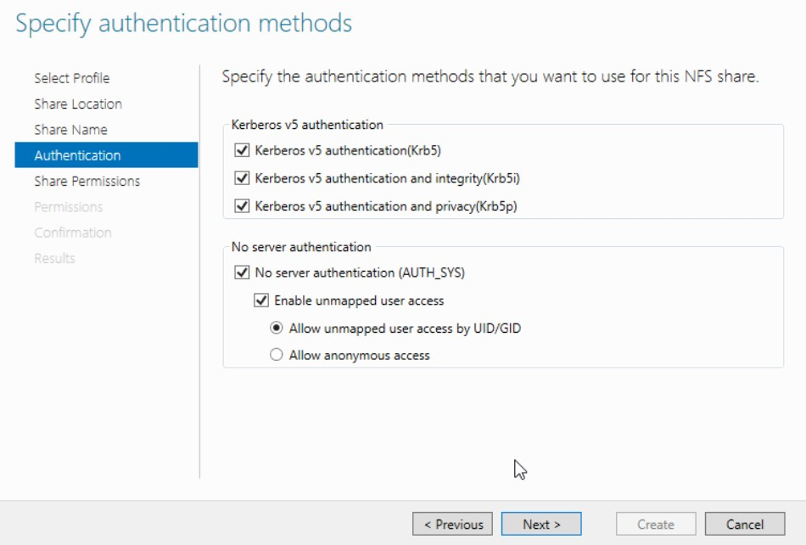
Specify share name-
Check all the boxes as followed -
2024 - RPS Consulting all rights reserved

Slide 31
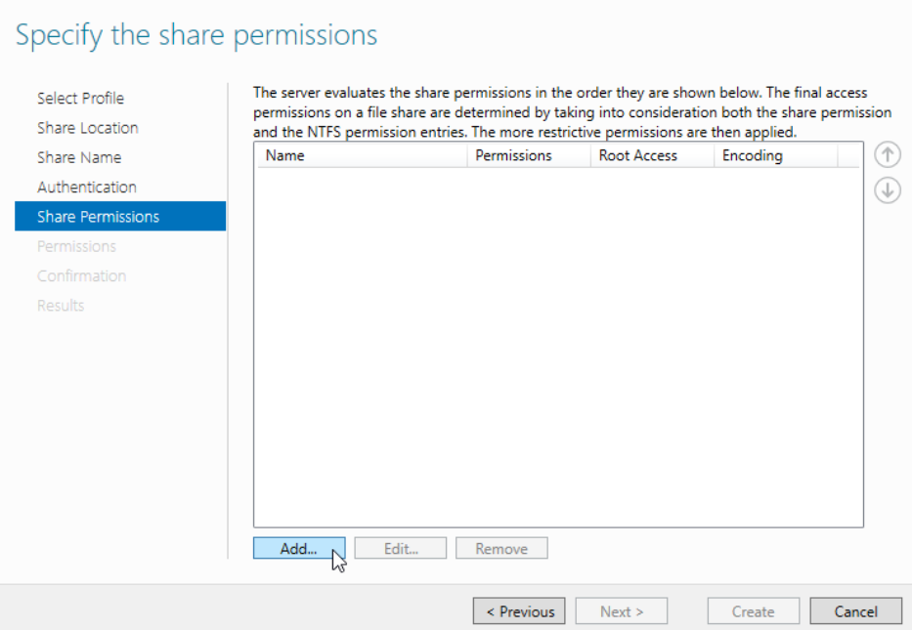
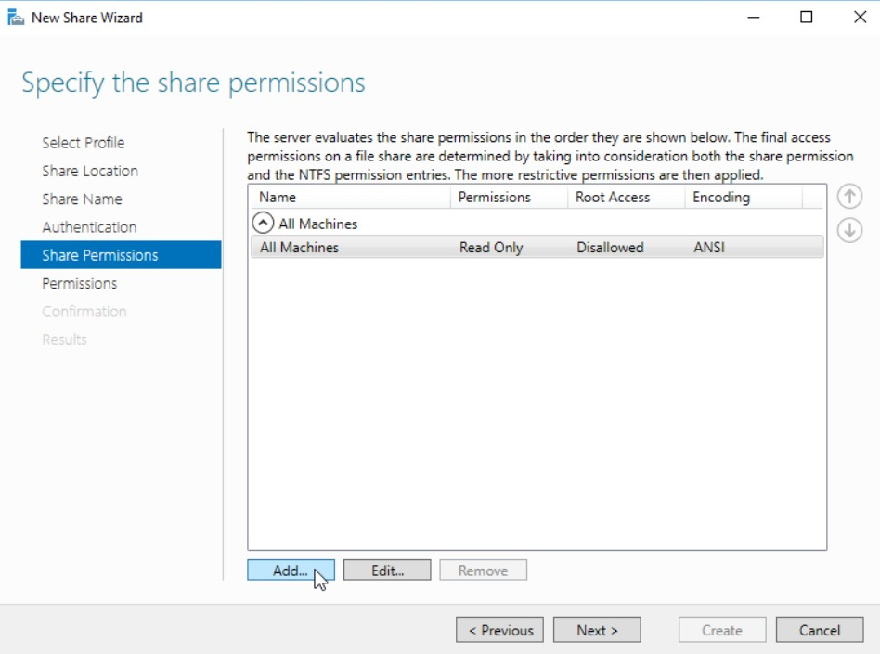
Click on Add to specify share permissions -
Select for All Machines and Read-Only Permissions -
2024 - RPS Consulting all rights reserved

Slide 32


Click on Add to add the principal -
Enter the ‘dcadmins’ group -
2024 - RPS Consulting all rights reserved

Slide 33


Specify the Permissions-
Click on create to create share-
2024 - RPS Consulting all rights reserved

Slide 34


Login to member machine and Click Add roles and features-
Select Client for NFS features -
2024 - RPS Consulting all rights reserved

Slide 35


Installation is in progress-
Open This PC on member machine and
select Map network drive-
2024 - RPS Consulting all rights reserved

Slide 36


Enter the network path of the created share-
Try to modify the file in the folder and
the access will be denied -
2024 - RPS Consulting all rights reserved

Slide 37
WIPRO NGA Program – Datacenter Batch
Capstone Project Presentation – 06 April 2024
Project Title - Task 2
Presented by - Avdhut Sanjay Bhaldand
www.rpsconsulting.in

Slide 38
Objective :
Install CentOS 7 server (after installation GUI must be present). Attach 3 disks of 5GB each & create 2 LVMs from these disks of 7GB (/lvm1) and 8GB (/lvm2) with XFS and EXT4 file systemsrespectively and verify. Install the following RPM packages using the package manager of your choice using single command.
www.rpsconsulting.in

Slide 39
Create New Virtual Machine
Select Typical-
2024 - RPS Consulting all rights reserved

Slide 40

Select I will install later-
Select the CentOS Version-
2024 - RPS Consulting all rights reserved

Slide 41


Specify VM Name-
Specify the disk capacity-
2024 - RPS Consulting all rights reserved

Slide 42

Select Customize Hardware-
Select memory size-
2024 - RPS Consulting all rights reserved

Slide 43
Select number of processors -
Select Use ISO image file option-
2024 - RPS Consulting all rights reserved

Slide 44


Browse and select the Server ISO image file-
Power ON this VM-
2024 - RPS Consulting all rights reserved

Slide 45

Hit Tab button and add ‘text’ to the line below-
2024 - RPS Consulting all rights reserved

Slide 46


Type 1 to set Time zone-
Select the region-
2024 - RPS Consulting all rights reserved

Slide 47

Type 4 for Software selection and
type 7 to select ‘Server with GUI’-
2024 - RPS Consulting all rights reserved

Slide 48


Type 5 for selecting disk -
2024 - RPS Consulting all rights reserved

Slide 49


Type 7 for Network configuration-
Type 1 to specify host name-
2024 - RPS Consulting all rights reserved

Slide 50


Type 2 for netwok configuration-
Type 8 for creating user-
2024 - RPS Consulting all rights reserved

Slide 51


Type 9 for User Creation-
Type 2 for specifying User name-
2024 - RPS Consulting all rights reserved

Slide 52


Type 5 to set password-
Type 6 to specify administrator privileges to user-
2024 - RPS Consulting all rights reserved

Slide 53

Type b to begin installation-
2024 - RPS Consulting all rights reserved

Slide 54

Installation Completed, hit enter -
2024 - RPS Consulting all rights reserved

Slide 55

Accept the Licence Agreement-
2024 - RPS Consulting all rights reserved

Slide 56


Login using root-
Tpye Command ‘startx’ to run GUI-
2024 - RPS Consulting all rights reserved

Slide 57


Change your linux server name to "LNX-SVR-01" using NMTUI command.
Change the IP address on linux to 192.168.10.10/24
Select Set System Hostname -
2024 - RPS Consulting all rights reserved

Slide 58


2024 - RPS Consulting all rights reserved

Slide 59


Select Edit a Connection to specify IP Address-
2024 - RPS Consulting all rights reserved

Slide 60


2024 - RPS Consulting all rights reserved

Slide 61


Open MySQL workbench setup
Enter the network path of the created share-
2024 - RPS Consulting all rights reserved

Slide 62

Run cmd systectlm restart network to update network-
2024 - RPS Consulting all rights reserved

Slide 63

Attach 3 disks of 5GB each & create 2 LVMs from these disks of
7GB (/lvm1) and 8GB (/lvm2) with XFS and EXT4 file systems
respectively and verify.
2024 - RPS Consulting all rights reserved

Slide 64


Run cmd ‘fdisk </dev/sd…>’ to create partion of disk-
2024 - RPS Consulting all rights reserved

Slide 65


2024 - RPS Consulting all rights reserved

Slide 66


2024 - RPS Consulting all rights reserved

Slide 67

Run cmd ‘pvcreate’ to create Physical volumes
Run cmd ‘vgcreate’ to create Volume groups
Run cmd ‘lvcreate’ to create Logical volumes -
2024 - RPS Consulting all rights reserved

Slide 68

Add file systems to the Logical volumes-
2024 - RPS Consulting all rights reserved

Slide 69

Make directories and mount the volumes to lvm-
2024 - RPS Consulting all rights reserved

Slide 70


Install the following RPM packages using the package manager of your choice using single command.
- VSFTPD
- PHP
- System-Config-Kickstart
- finger.
2024 - RPS Consulting all rights reserved

Slide 71


Use appropriate commands to start and kill the ‘yes’ process and verify
Process 1-
Run process ‘yes’ in second tab and type following commands in tab 1-
Check in tab 2 the process gets killed/terminated-
2024 - RPS Consulting all rights reserved

Slide 72



Process 2-
Run process ‘yes’ in second tab and type following commands in tab 1-
After running top command press ‘k’ to kill process and type process id-
2024 - RPS Consulting all rights reserved

Slide 73
WIPRO NGA Program – Datacenter Batch
Capstone Project Presentation – 06 April 2024
Project Title - Task 6
Presented by - Avdhut Sanjay Bhaldand
www.rpsconsulting.in

Slide 74
Objective :
Use MySQL workbench and create an employee database. Create a table empdetails (emp_id, Name, Age, Salary, Position). Create another table emplocation (emp_id, location). Create primary key & foreign key in the tables accordingly and perform CRUD operation on the table. Use joins to display “emp_id, Name, Age, Salary, location”
using primary key & foreign key concept.
www.rpsconsulting.in

Slide 75

Open MySQL workbench setup
2024 - RPS Consulting all rights reserved

Slide 76

Click on MySQL Connections
2024 - RPS Consulting all rights reserved

Slide 77

Open new Query Tab
2024 - RPS Consulting all rights reserved

Slide 78

Create a database ‘employee’
2024 - RPS Consulting all rights reserved

Slide 79

Create a table ‘empdetails’ & insert data
2024 - RPS Consulting all rights reserved

Slide 80

Create another table ‘emplocation’ & insert data
2024 - RPS Consulting all rights reserved

Slide 81

Updating data in empdetails
2024 - RPS Consulting all rights reserved

Slide 82

Deleting data in emplocation
2024 - RPS Consulting all rights reserved

Slide 83

Reading data using inner join to display (emp_id, Name, Age, Salary, location) as a single output
2024 - RPS Consulting all rights reserved

Slide 84
THANK YOU!!!

